Slide 1

Essilor® Stellest® lenses
The first and only FDA market authorized spectacle lens to slow myopia progression in children*¹
* Euromonitor, Eyewear 2024 edition; Essilor International company; worldwide retail value sales at RSP.
† Compared to single vision lenses. Results from a prospective, randomized, double-masked, multicenter U.S. clinical trial in myopic children aged 6–12 years at initiation of treatment.
1. Essilor International, data on file (2025)

Slide 2
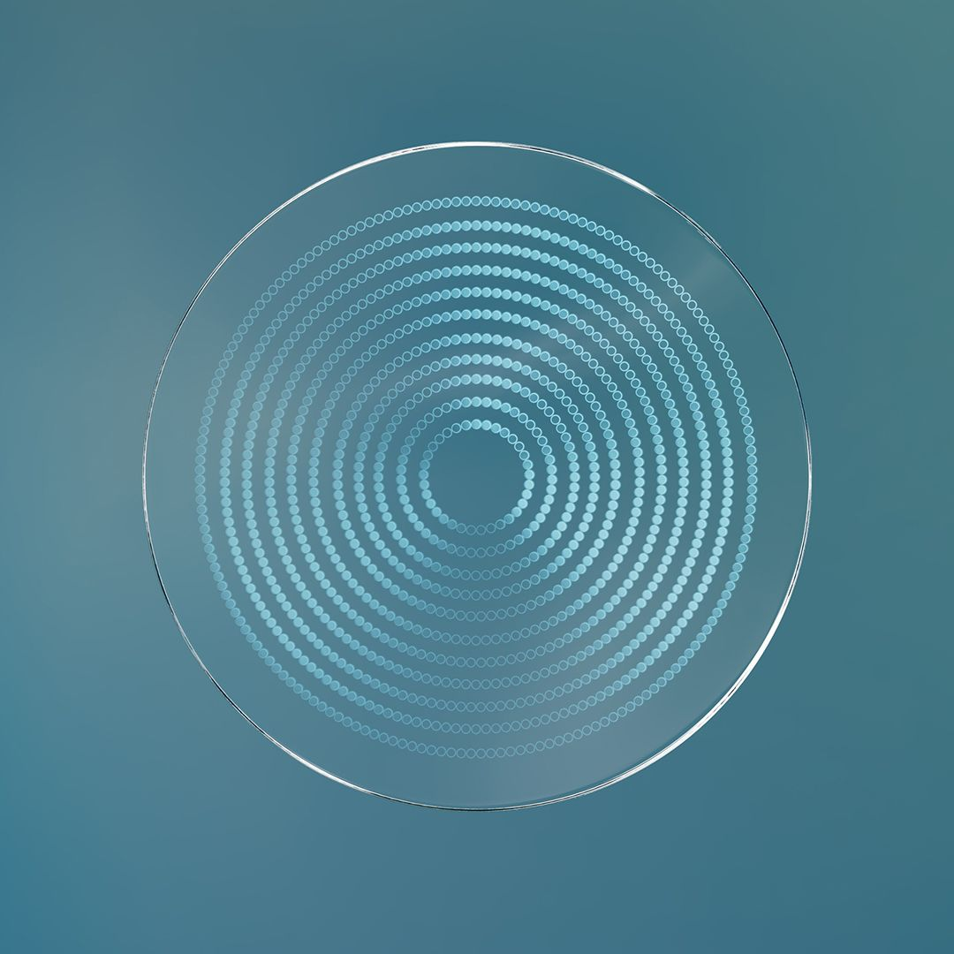
What Essilor® Stellest® lenses offer to children with myopia
SINGLE VISION ZONE
Correct myopia
Slow myopia progression
Essilor® Stellest® lenses slowed myopia progression by 71% on average over 2 years†¹
An easy to use and proven¹ way to help manage myopia in children
*H.A.L.T. Highly Aspherical Lenslet Target. H.A.L.T. is an acronym for Highly Aspherical Lenslet Target and does not imply a “halt” or “stop” of myopia progression.
†Compared to single vision lenses. Results from a prospective, randomized, double-masked, multicenter U.S. clinical trial in myopic children aged 6–12 years at initiation of treatment
1. Essilor International, data on file (2025)
H.A.L.T.* TECHNOLOGY

Slide 3

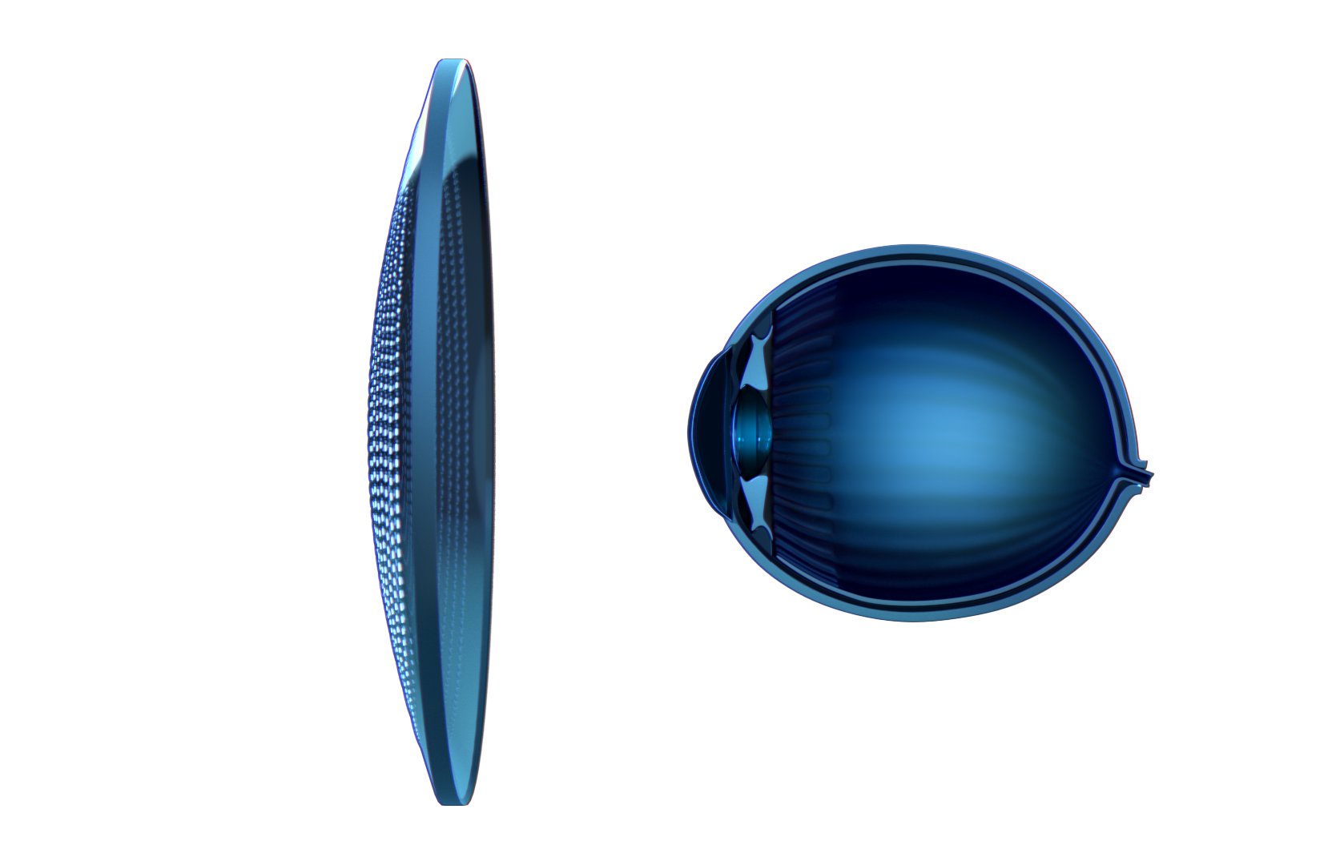
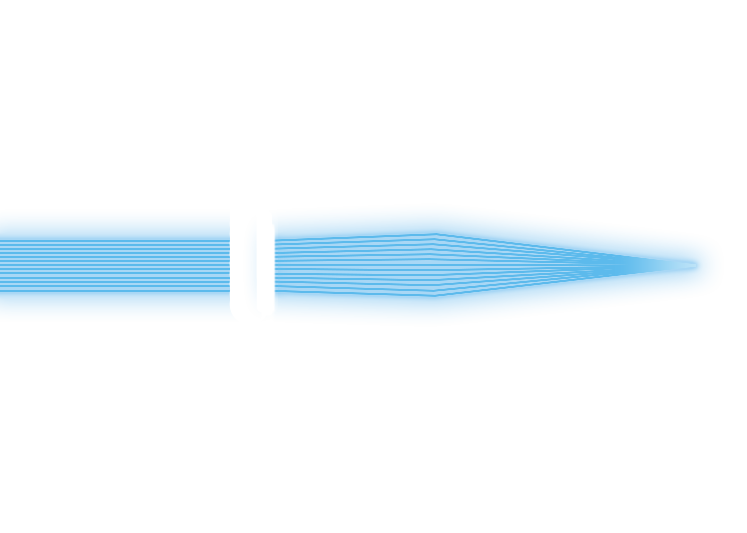
Correct myopia through a single vision zone carrying the prescription of the wearer
Correction
The single vision zone focuses light on the retina and is designed to provide sharp vision
The lens design ensures a large prescription
zone providing best corrected visual acuity and comfort
Notes:
•The Essilor® Stellest® lens corrects the child’s myopic prescription through a central single-vision zone. Light rays from a distant object pass through this zone, and upon entering the eye, are focused precisely on the retina, providing clear vision in any direction

Slide 4
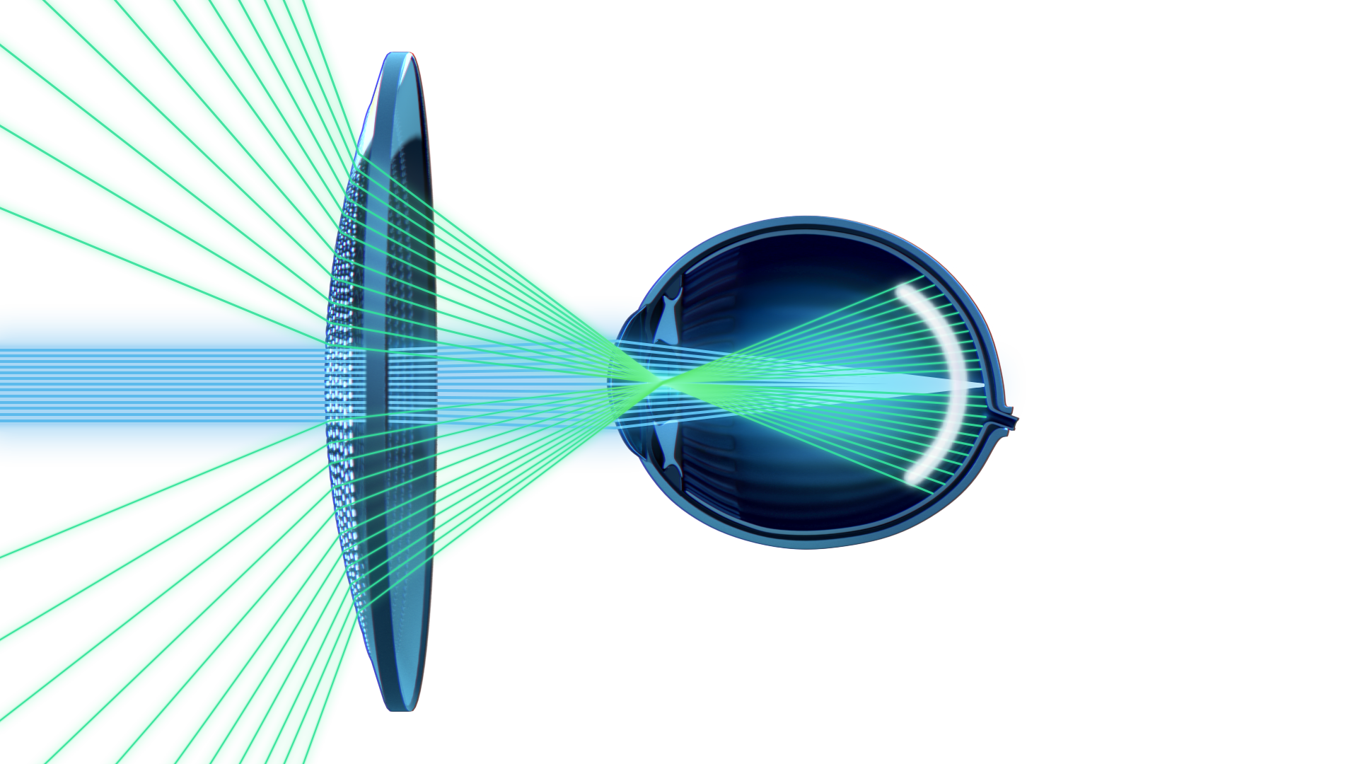
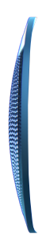
Slow myopia progression with H.A.L.T.* technology^{†1}
Essilor® created Highly Aspherical Lenslet Target (H.A.L.T.*) technology to slow down myopia progression.
H.A.L.T.* technology comprises 1021 highly aspherical contiguous lenslets, arranged over 11 rings. Light rays passing through the aspherical lenslets create a volume of myopic defocus in front of the retina and which follows the shape of a child’s theoretical myopic retina,² to slow down eye elongation.
*H.A.L.T. is an acronym for Highly Aspherical Lenslet Target and does not imply a “halt” or “stop” of myopia progression.
†Compared to single vision lenses. Results from a prospective, randomized, double-masked, multicenter U.S. clinical trial in myopic children aged 6–12 years at initiation of treatment.
1. Essilor International, data on file (2025); 2. Atchison DA. Optical models for human myopic eyes. Vision Res 2006; 46: 2236–50
Notes:
The Essilor® Stellest® lens slows myopia progression using Highly Aspherical Lenslet Target (H.A.L.T.) technology. The lens is made up of 11 concentric rings of contiguous lenslets, with a total of 1,021 lenslets. Each lenslet has an aspherical shape.
The lenslets are on the front side, Rx is on back side.
Within a single ring, all lenslets share the same optical design, but lenslets in different rings have different designs. Essilor scientists carefully calculated the geometry of the lenslets in each ring so that the resulting volume of myopic defocus matches the shape of a myopic retina.
•It is important to note that this signal, as it is made of a myopic defocus signal, cannot be used by the child as a stimulus for vision. It is only here to serve as a stop signal to the retina.

Slide 5

Deep dive into H.A.L.T.* technology
Aspherical lenslets
Result: A volume of myopic defocus.
Spread on 11 rings
The lenslets of the same ring are identical. The lenslets of different rings have different optical characteristics.
Result: A volume of slowdown signal in front of the retina and following its shape.
Covering 40% of the lens surface
Result: A myopia control function active in all gaze directions.
*H.A.L.T. is an acronym for Highly Aspherical Lenslet Target and does not imply a “halt”or “stop” of myopia progression.
Notes:
In summary, the aspherical lenslets create a volume of myopic defocus. With 11 rings of lenslets, each ring having different optical characteristics, this generates a slowdown signal in front of the retina that follows its shape. The lenslets cover 40% of the lens surface, providing myopia progression control function in all gaze areas.”

Slide 6
Essilor® Stellest® lenses
Clinically proven to slow myopia progression in children^{*1}
*Compared to single vision lenses. Results from a prospective, randomized, double-masked, multicenter U.S. clinical trial in myopic children aged 6–12 years at initiation of treatment.
1. Essilor International, data on file (2025)

Slide 7
Essilor® Stellest® lenses clinical trial demonstrated an acceptable safety profile and positive benefit-risk assessment
PROSPECTIVE, RANDOMIZED, DOUBLE-MASKED MULTICENTER CLINICAL TRIAL
INCLUSION CRITERIA
Location: 9 clinical sites in US
Duration: 3 years
Essilor® Stellest® lens: 69 children
Single Vision Lens (SVL): 66 children
6-monthly visits
ClinicalTrials.gov identifier: NCT05174780
Age: 6-12 years
Myopia: -0.75D to -4.50D
Astigmatism: ≤1.50D
Anisometropia: ≤1.00D
Normal vision
No history of myopia control
Notes:
A prospective, randomized, double-masked, multicenter clinical trial was conducted across nine sites in the U.S. to evaluate the safety and effectiveness of Essilor® Stellest® lenses in slowing myopia progression in a representative U.S. population. A prospective, randomized, double-masked, multicenter clinical trial is a high-quality scientific study designed to provide strong evidence for a treatment's effectiveness and safety. It is prospective because it follows participants forward in time to observe outcomes, randomized by assigning participants by chance to different treatment groups, double-masked because neither the participants nor the researchers know who receives which treatment, and multicenter because the study is conducted at multiple sites to increase the sample size and diversity of participants.
The trial is planned for three years, with two-year results currently available.
At the two-year point, 69 children wearing Essilor® Stellest® lenses and 66 children wearing single-vision lenses were analyzed, with study visits conducted every six months.
Eligibility criteria included children aged 6 to 12 years with a myopic prescription between –0.75 and –4.50 D, astigmatism ≤ –1.50 D, and anisometropia ≤ 1.00 D.
Participants were required to have normal vision and no prior history of treatments aimed at slowing myopia progression.
Average vision was 20/20 in all participants and no significant difference in high and low contrast vision in those wearing Stellest versus Single vision when viewing through the central zone at all visits and at 2 years.

Slide 8
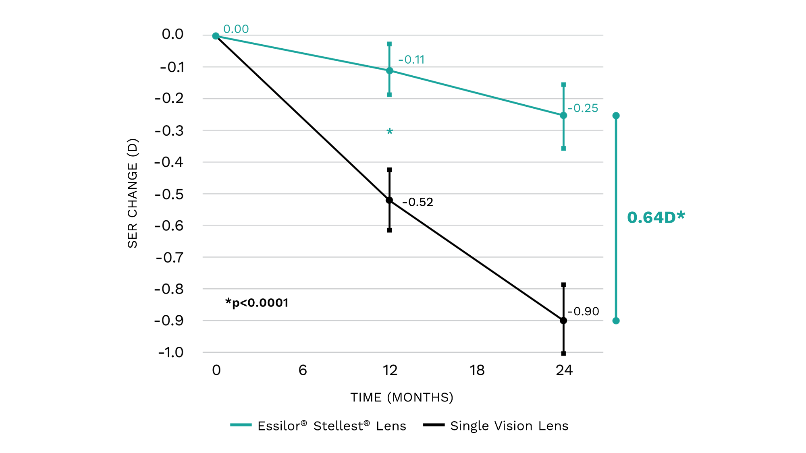
Clinically proven to slow myopia progression in children^{†1}
Essilor® Stellest® lenses slowed myopia progression by 71% (0.64D) on average for all subjects over 2 years^{†1}
*
Mean change in Spherical Equivalent Refraction (D) – adjusted values. Error bars represent 95% confidence intervals. Myopia progression in SVL group is consistent with published data in Caucasian children.²
*p<0.0001
†Compared to single vision lenses. Results from a prospective, randomized, double-masked, multicenter U.S. clinical trial in myopic children aged 6–12 years at initiation of treatment.
1. Essilor International, data on file (2025)

Slide 9
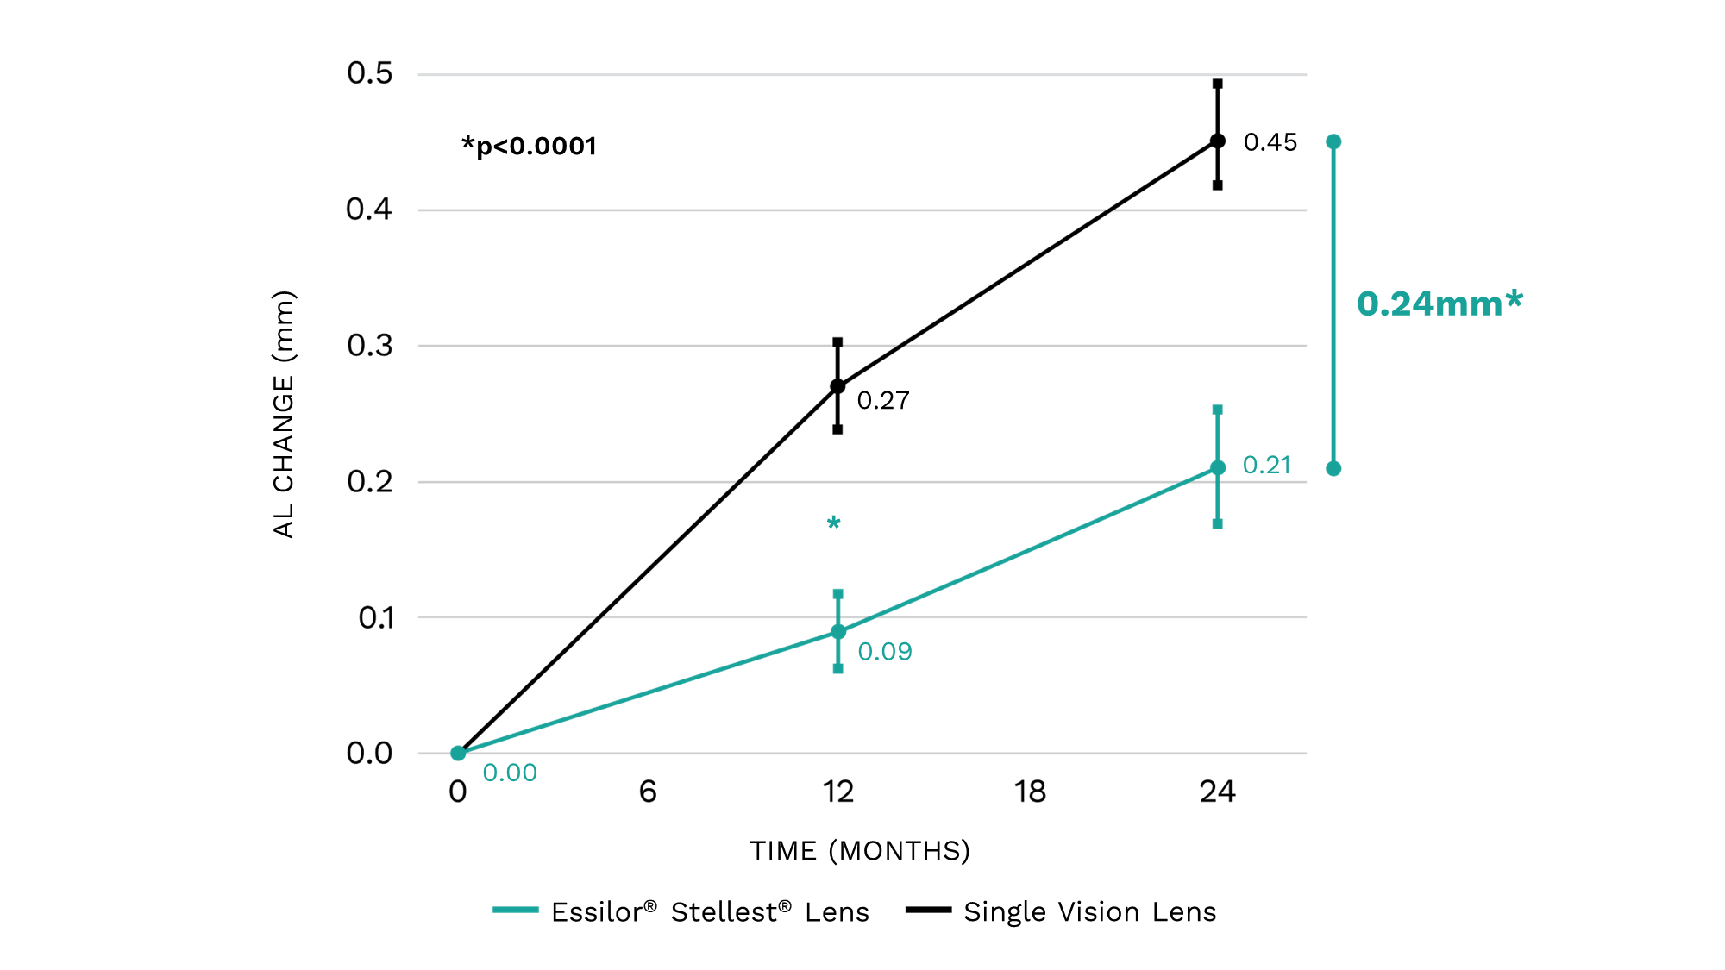
Clinically proven to slow axial elongation in children^{†1}
Essilor® Stellest® lenses slowed axial elongation by 53% (0.24mm) on average for all subjects over 2 years^{†1}
Mean change in axial length (mm) – adjusted values. Error bars represent 95% confidence intervals. Axial elongation in single vision lens group is consistent with published data in Caucasian children.²
*p<0.0001
†Compared to single vision lenses. Results from a prospective, randomized, double-masked, multicenter U.S. clinical trial in myopic children aged 6–12 years at initiation of treatment.
1. Essilor International, data on file (2025)

Slide 10
Essilor® Stellest® lenses
The breakthrough* in children’s eye care that parents have been waiting for
*The U.S. Food and Drug Administration (FDA) granted Breakthrough Device designation to the Essilor® Stellest® spectacle lens in April 2021

Slide 11
A quick reminder of Essilor® Stellest® lenses' key benefits
SINGLE VISION ZONE
Correct myopia
Slow myopia progression
Essilor® Stellest® lenses slowed myopia progression by 71% on average over 2 years†¹
An easy to use and proven¹ way to help manage myopia in children
*H.A.L.T. Highly Aspherical Lenslet Target. H.A.L.T. is an acronym for Highly Aspherical Lenslet Target and does not imply a “halt” or “stop” of myopia progression.
†Compared to single vision lenses. Results from a prospective, randomized, double-masked, multicenter U.S. clinical trial in myopic children aged 6–12 years at initiation of treatment
1. Essilor International, data on file (2025)
H.A.L.T.* TECHNOLOGY
H.A.L.T.* TECHNOLOGY

Slide 12
Indication for Use
INDICATIONS FOR USE
The Essilor® Stellest® spectacle lens is indicated for the correction of myopia with and without astigmatism and for slowing the progression of myopia in children with non-diseased eyes, who, at the initiation of treatment,
are aged 6-12 years and have spherical equivalent refraction of -0.75 D to - 4.50 D with astigmatism up to 1.50 D.
RECOMMENDED WEARING SCHEDULE
It is recommended that the patient wears their Essilor® Stellest® spectacle lenses for a minimum of 10 hours per day, at least 6 days per week. This is the first FDA-authorized eyeglass lens designed to slow myopia progression.

Slide 13

Additonal benefits of Essilor® Stellest® lenses
Essilor® Stellest® Lenses are made from polycarbonate
Up to 40 times
More impact resistant*
Up to 16% lighter†
Up to 21% thinner†
Blocks 100%
of UV‡
Crizal® coating ​
Crizal® coating is the Essilor® Stellest® lenses treatment that acts as an invisible shield of protection. Combined with Essilor® Stellest® lenses, Crizal® protects the lenses from reflections, scratches, smudges, dust, water; and the eyes from UV rays.
A wide choice of frames ​
*Test realised on multiple materials 1.50, 1.53, 1.56, 1.60, 1.71 and 1.74 in comparison with 1.59 by an accredited external laboratory using method defined in the safety US standard ANSI/ISEA Z87.1- 2020 clause(s) 7.1.4.3 on High Velocity Impact and 9.14 on Prescription Lenses Material Qualification Test using plano Lenses with the same hard coat and 2.0mm+/-0.2mm center thickness.
†compared to 1.50 Lenses
‡ISO 8980-3 Standard defines UV upper limit at 380nm

Slide 14
Dispensing Essilor®
Stellest® lenses
Seamless to prescribe, simple to dispense, proven to perform*¹
*Compared to single vision lenses. Results from a prospective, randomized, double-masked, multicenter U.S. clinical trial in myopic children aged 6–12 years at initiation of treatment.
1. Essilor International, data on file (2025)

Slide 15


Who?
Essilor® Stellest® lenses can be recommended to children, as soon as myopia progression has been detected in a child, after an eye exam performed by an eye care professional (optometrist/ophthalmologist)
Early intervention would be beneficial^{1,2}
1. Sankaridurg P. A less myopic future: what are the prospects?. Clinical and Experimental Optometry. 2015;98(6):494-6
2. Bullimore MA, et al. Myopia: An ounce of prevention is worth a pound of cure. Ophthalmic and Physiological Optics. 2023;43(1):116-21

Slide 16

How to introduce Essilor® Stellest® lenses?
1
Educate parents on the importance of slowing myopia progression
STEP
Make sure parents understand that correcting myopia with single vision lenses is not enough, and slowing myopia progression should be the right solution for their myopic children.
2
Introduce Essilor® Stellest® lenses
STEP
Explain the product, its efficacy with proven clinical trial results, and its additional benefits.
3
Give recommendations to maximize effectiveness
STEP
Provide additional patient education for slowing down myopia progression, such as having regular eye exams, more outdoor time, limiting near work etc.
Notes:
This slide is intended for ODs as Essilor® Stellest®lenses requires OD prescription

Slide 17
Essilor® Stellest® lenses – product range
​ | Essilor® Stellest® lenses
Technology​ | H.A.L.T.*​
Sphere / cylinder power*​ | SPH [0.00; -10.00] CYL [0.00; -4.00]
Coating​ | Crizal® Easy pro
Material​ | 1.59 polycarbonate​
UV cut off​ | 100% UV protection†
CYL, cylinder; SPH, sphere.
*H.A.L.T. is an acronym for Highly Aspherical Lenslet Target and does not imply a “halt” or “stop” of myopia progression.
†By absorption. Additional UV back side reflection reduction when combined with Crizal® coating.​

Slide 18
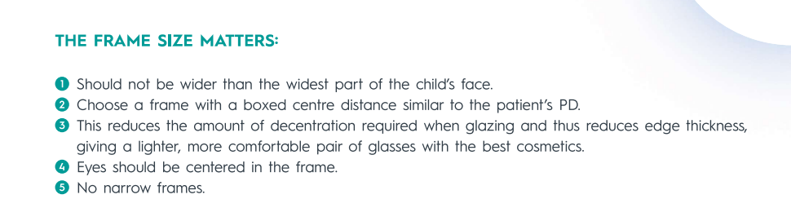
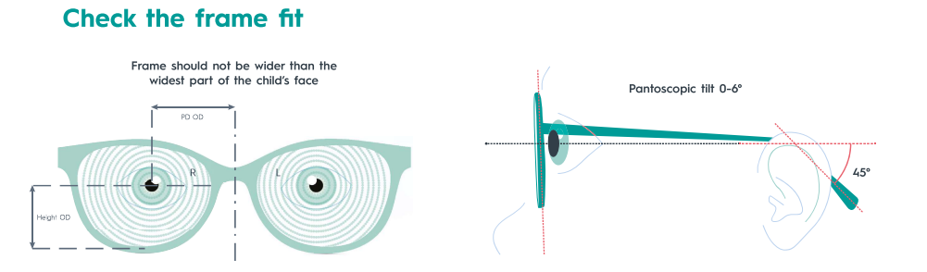
Frame selection
Frame parameters :
Pantoscopic angle ~ 0° (vs adults ~8°)
Wrap angle ~ 0°
Back vertex distance < 12 mm

Slide 19
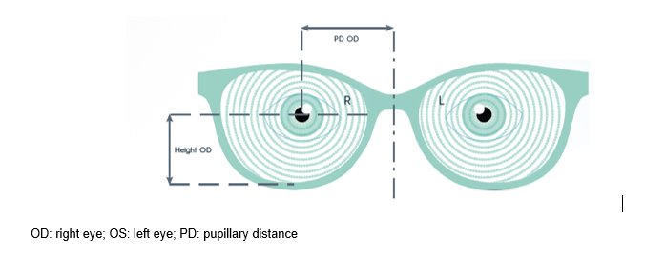
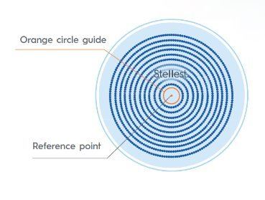
Fitting Essilor® Stellest® lenses
HORIZONTALLY
VERTICALLY
CENTRATION
monocular pupillary
distances OD and OS
monocular heights OD and OS :
mark the monocular pupil centers in horizontal gaze direction
The position of the reference point is the center of the rings of the lenslets. It is the point where the prescription is measured and controlled. This marking (dot) is to be used as the reference point for the centering of the lens (center of pupil). ​
19 |

Slide 20
Recommended follow up
1. First follow-up visit after 2 weeks
(Dispensing Eye Care Professional)
Check for adaptation and compliance/wearing time
Frame fitting check
Ask about vision at distance and near
Answer any questions the patient and parents may have
If needed, additional visits to adjust the frame
2. Follow-up every 6 months
(Prescribing Eye Care Professional)
Distance & near visual acuity
Check compliance/wearing time
Objective and subjective refraction and axial length measurement as indicated
Best corrected visual acuity
Any additional test or examination as clinically indicated
3. Annual comprehensive eye examination
(Prescribing Eye Care Professional)
Update Essilor® Stellest® spectacle lenses if Rx progression is 0.50D or more
Ongoing monitoring should include objective and subjective refraction at 6-month intervals, as indicated by the prescribing eye care professional
Source: Essilor International. Essilor® Stellest® spectacle lenses: Professional fitting and information guide. Instructions for Use. September 2025.

Slide 21
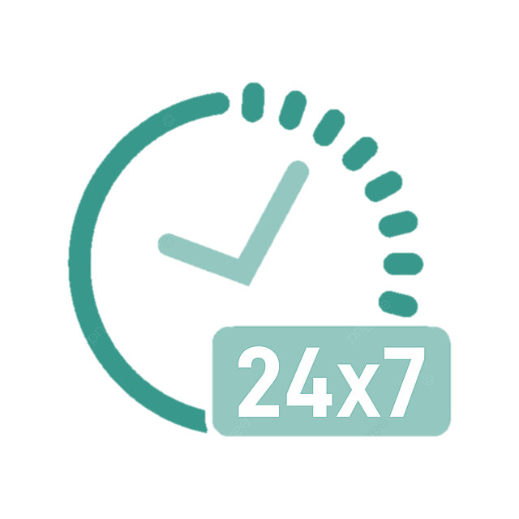
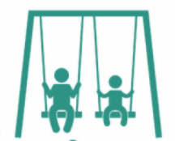
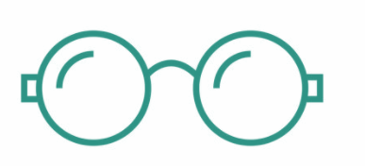

Recommendations
Encourage child to wear their Essilor® Stellest® spectacle lenses consistently: minimum of 10 hours per day for at least 6 days per week
Spend time outside everyday playing, walking, to be exposed to the natural daylight. It is recommended to spend 2h per day outside.
Observe the adaptation phase and ensure
that the frame is well fiited and later the size of frame is still suitable
Lifestyle advice
The 20/20 rule: every 20 min, advise to look away at least 20 seconds during near work activities

Slide 22
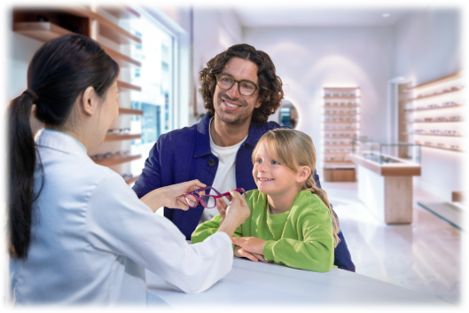
Initial Dispense
What to check when the patient is here to collect their glasses with Essilor® Stellest® lenses:
Verify frame fit and adjust if necessary
15-minute spectacle trial (e.g., reading, walking), to ensure vision feels clear
Recommended that the patient wears Essilor® Stellest® spectacle lenses as much as possible
Advise there may be an adaptation period of up to 1 week
If there is any discomfort or their vision does not feel right, advise to please return to their eye care professional
Ensure follow-up with OD is scheduled
Source: Essilor International. Essilor® Stellest® spectacle lenses: Professional fitting and information guide. Instructions for Use. September 2025.

Slide 23





Regulatory
Breakthrough designation using De Novo pathway April 2021
Class II medical device as defined by FDA moderate risk classification
Developed in close collaboration and communication with FDA as a novel breakthrough device. Given priority review consideration by FDA as a result of the designation
Special controls include complaint monitoring. Contact information included in the patient and caregiver guide
The Essilor® Stellest® spectacle lens is a class 2 product according to FDA regulation. The following symbols may appear on the label:
Symbol | Meaning
 | Caution: Federal (USA) law restricts this device to sale by or on the order of a licensed practitioner.
 | Legal Manufacturer
 | Date of Manufacture
 | CE Marking (European regulation relating to medical devices).
 | Medical Device
 | Catalogue or Model Number

Slide 24
Set your practice apart with the first and only FDA market authorized spectacle lens designed for myopia control in children*¹
*Compared to single vision lenses. Results from a prospective, randomized, double-masked, multicenter U.S. clinical trial in myopic children aged 6–12 years at initiation of treatment.
1. Essilor International, data on file (2025)

